Slide 1


Data Analyst Internship
Task: Diabetes Predication
Name: Kirthik Ramadoss
Email: kirthikramadoss07@gmail.com

Slide 2
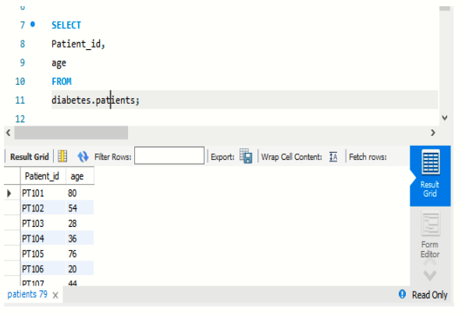
1. Retrieve the Patient_id and ages of all patients.

Slide 3
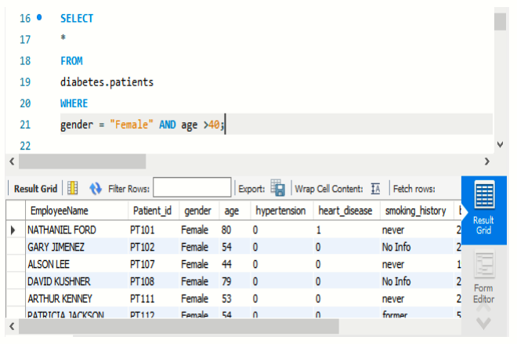
2. Select all female patients who are older than 40.

Slide 4
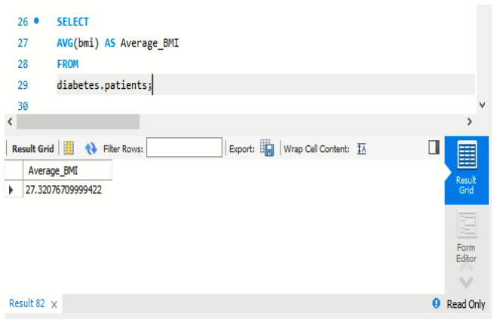
3. Calculate the average BMI of patients.

Slide 5
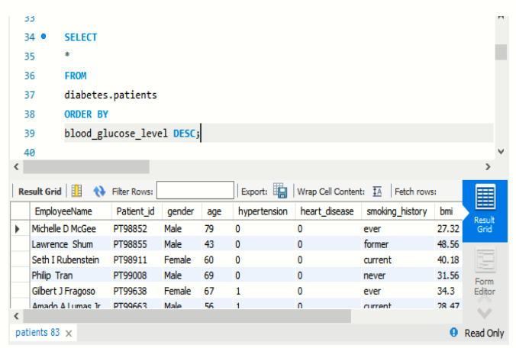
4. List patients in descending order of blood glucose levels.

Slide 6
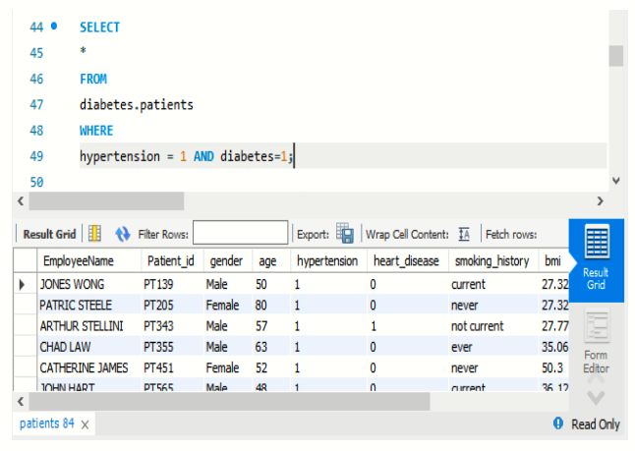
5. Find patients who have hypertension and diabetes.

Slide 7
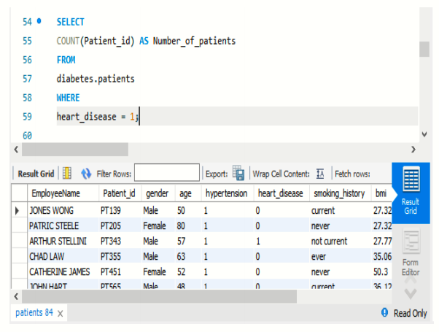
6. Determine the number of patients with heart disease.

Slide 8
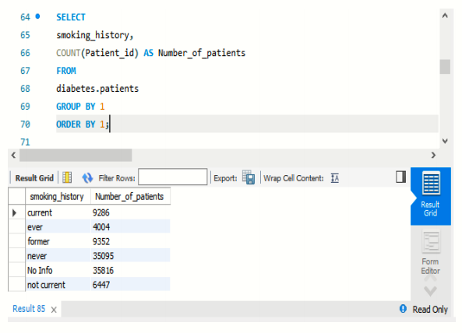
7. Group patients by smoking history and count how many smokers and non-smokers there are.

Slide 9
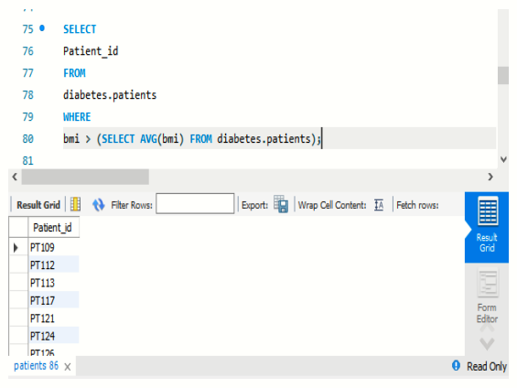
8. Retrieve the Patient_ids of patients who have a BMI greater than the average BMI.

Slide 10
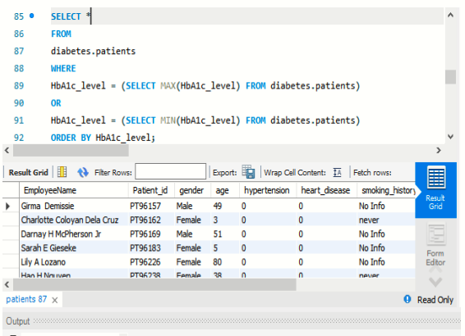
9. Find the patient with the highest HbA1c level and the patient with the lowest HbA1 level.

Slide 11
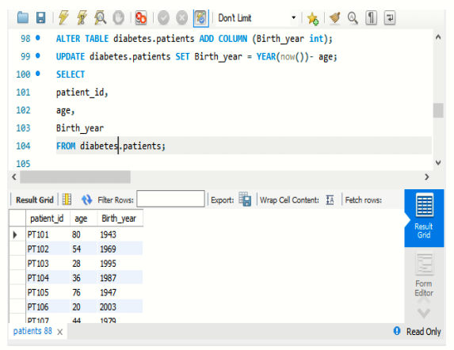
10. Calculate the age of patients in years (assuming the current date as of now).

Slide 12
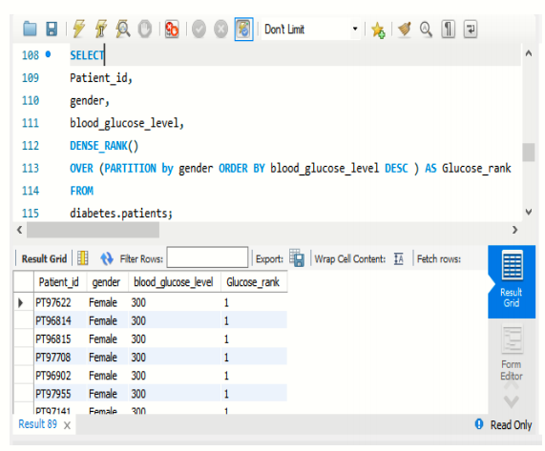
11. Rank patients by blood glucose level within each gender group.

Slide 13
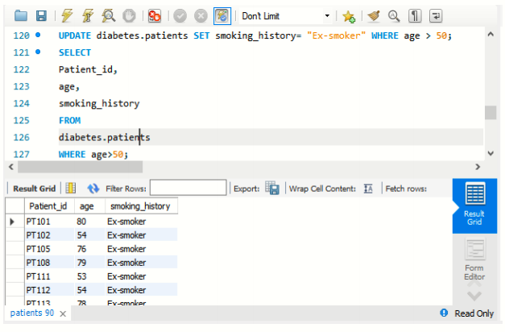
12. Update the smoking history of patients who are older than 50 to "Ex-smoker."

Slide 14
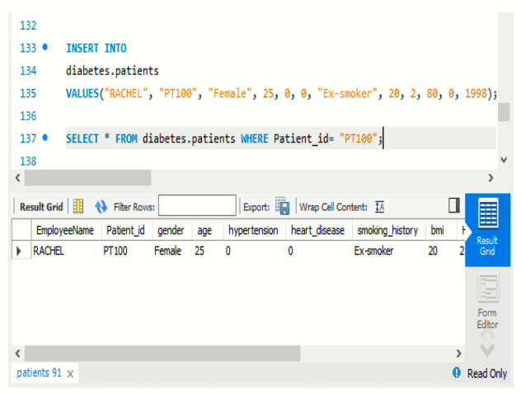
13. Insert a new patient into the database with sample data.

Slide 15
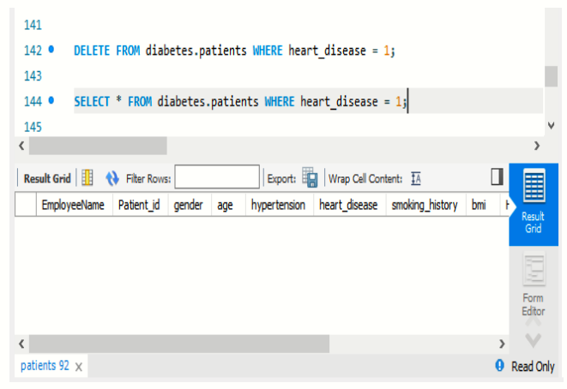
14. Delete all patients with heart disease from the database.

Slide 16
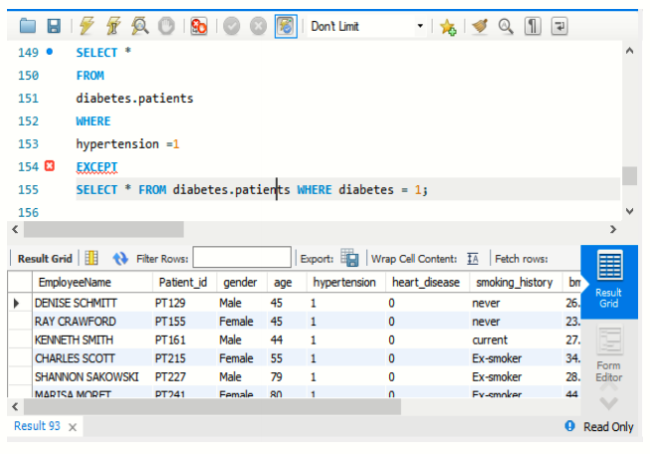
15. Find patients who have hypertension but not diabetes using the EXCEPT operator.

Slide 17
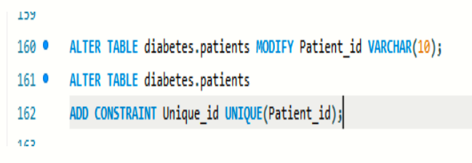
16. Define a unique constraint on the "patient_id" column to ensure its values are unique.

Slide 18
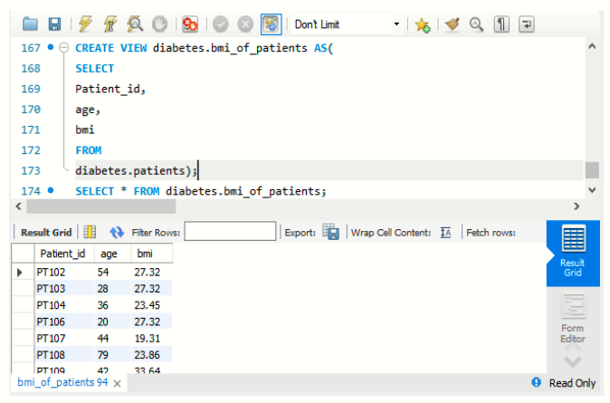
17. Create a view that displays the Patient_ids, ages, and BMI of patients.

Slide 19
18. Suggest improvements in the database schema to reduce data redundancy and improve data integrity.
Normalize Data:
Break down data into smaller tables (1NF, 2NF, 3NF) to reduce redundancy.
Establish Relationships:
Use foreign keys and constraints for data relationships.
Optimize Data Types:
Choose efficient data types and sizes to save space.
Use Views and Indexes:
Simplify queries with views; optimize performance with indexes.
Careful Denormalization:
Consider denormalization selectively for performance.
Include Audit Trails:
Implement logs for tracking changes and maintaining history.
Regular Maintenance:
Schedule updates, backups, and consistency checks.
Enforce Validation Rules:
Ensure strict validation during data entry.
Cleansing Procedures:
Set up periodic data cleansing processes.
Stored Procedures:
Utilize for complex data operations and code consistency.

Slide 20
19. Explain how you can optimize the performance of SQL queries on this dataset.
Indexing:
Use appropriate indexes on frequently used columns.
Query Optimization:
Select only needed columns, optimize WHERE clauses, and
simplify joins.
Statistics Update:
Regularly update statistics for efficient query plans.
Partitioning and Archiving:
Partition large tables and archive older data.
Maintenance and Monitoring:
Perform Regular maintenance and monitor
performance.
Query Tuning:
Identify and tune problematic queries using profiling tools.

Slide 21


